Slide 1

Problem statement

Slide 2
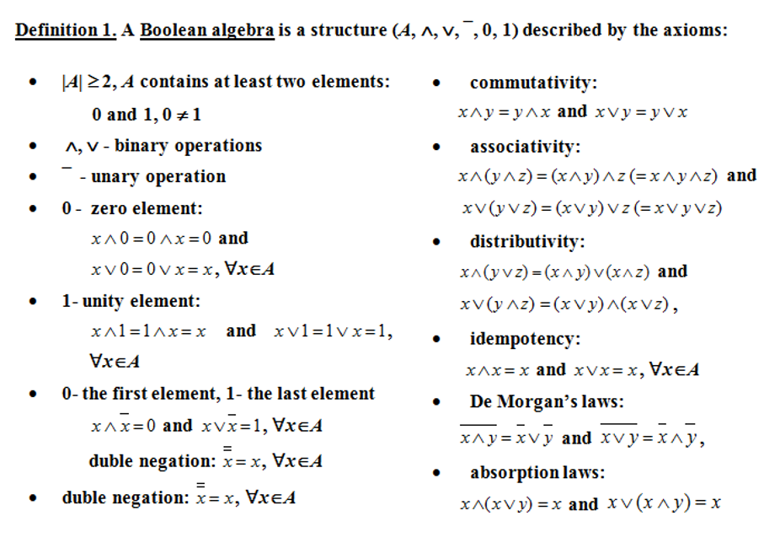
Theoretical results

Slide 3

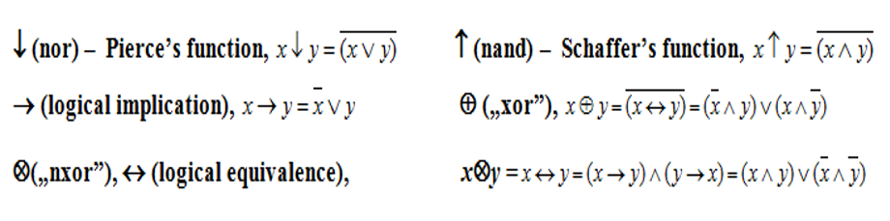
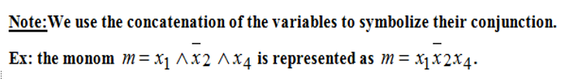
Theoretical results

Slide 4
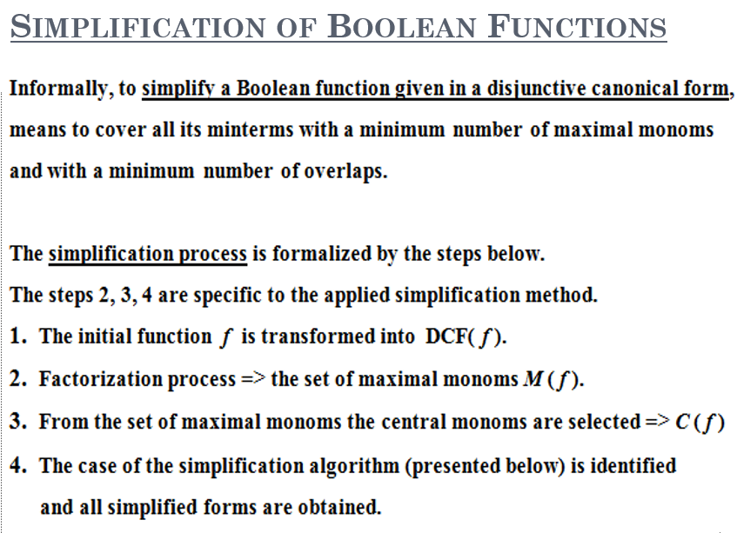
Theoretical results

Slide 5
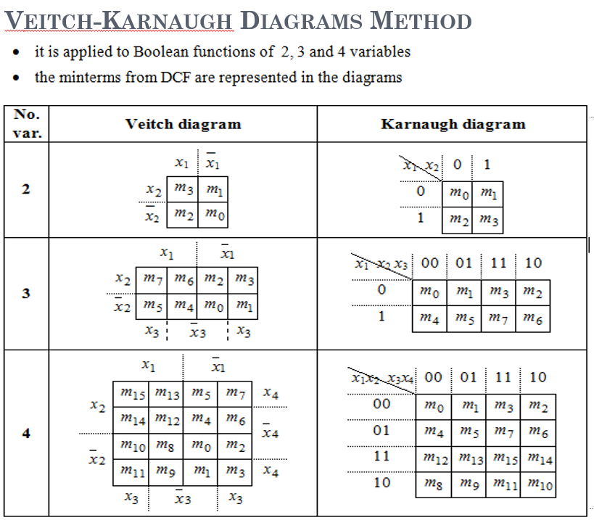
Theoretical results

Slide 6
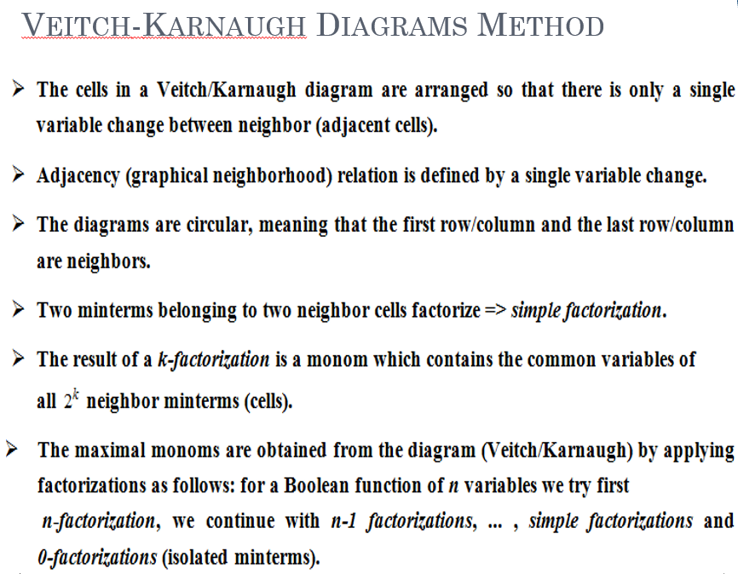
Theoretical results

Slide 7



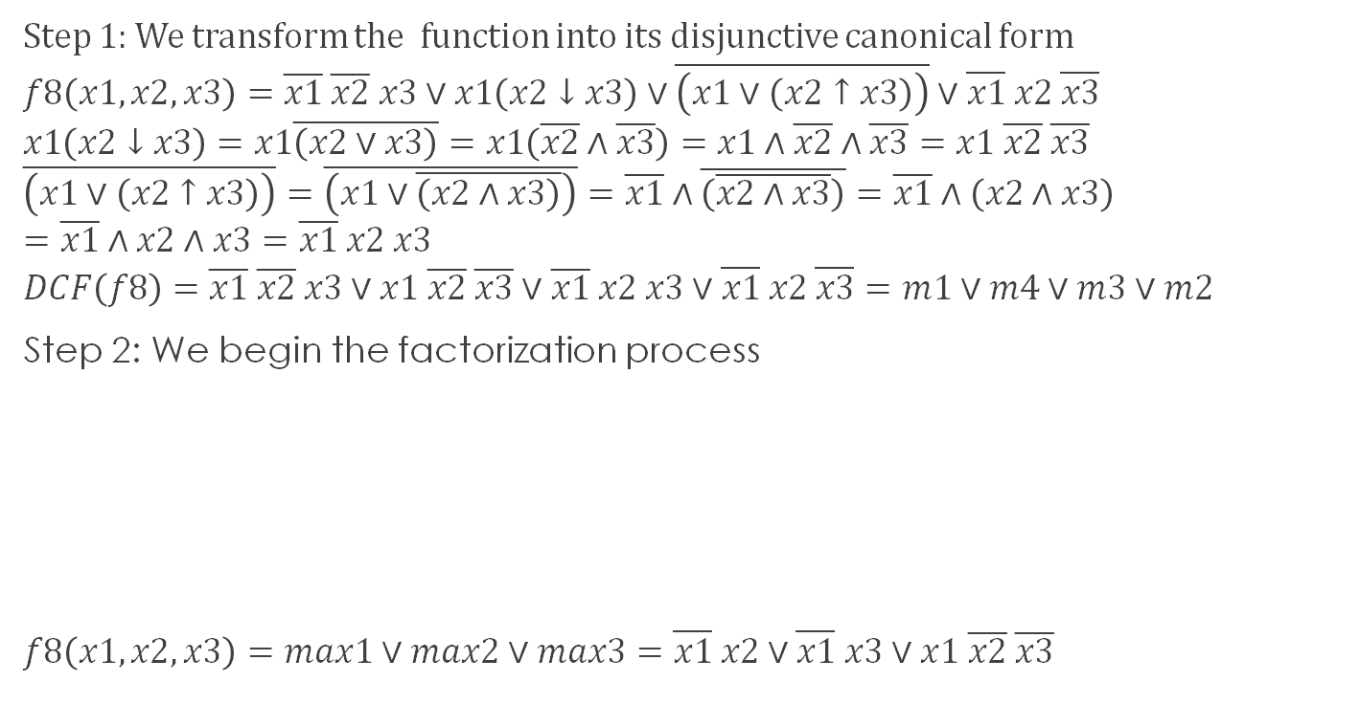


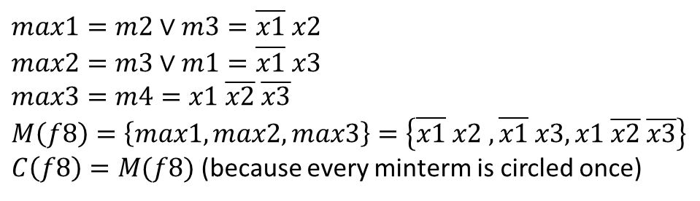


Solve
Step 1: We transform the function into its disjunctive canonical form
$$f8\left(x1,x2,x3\right)=\overline{x1} \overline{x2} x3∨x1\left(x2↓x3\right)∨\overline{\left(x1∨\left(x2↑x3\right)\right)}∨\overline{x1} x2 \overline{x3}$$
$$x1\left(x2↓x3\right)=x1\overline{\left(x2∨x3\right)}=x1\left(\overline{x2}∧\overline{x3}\right)=x1∧\overline{x2}∧\overline{x3}=x1 \overline{x2} \overline{x3}$$
$$\overline{\left(x1∨\left(x2↑x3\right)\right)}=\overline{\left(x1∨\overline{\left(x2∧x3\right)}\right)}=\overline{x1}∧\overline{\left(\overline{x2∧x3}\right)}=\overline{x1}∧\left(x2∧x3\right)=\overline{x1}∧x2∧x3=\overline{x1} x2 x3$$
$$DCF\left(f8\right)=\overline{x1} \overline{x2} x3∨x1 \overline{x2} \overline{x3}∨\overline{x1} x2 x3∨\overline{x1} x2 \overline{x3}=m1∨m4∨m3∨m2$$
Step 2: We begin the factorization process
$$f8\left(x1,x2,x3\right)=max1∨max2∨max3=\overline{x1} x2∨\overline{x1} x3∨x1 \overline{x2} \overline{x3}$$
$$x1$$
$$\overline{x1}$$
$$max1=m2∨m3=\overline{x1} x2$$
$$max2=m3∨m1=\overline{x1} x3$$
$$max3=m4=x1 \overline{x2} \overline{x3}$$
$$M\left(f8\right)=\left\{max1, max2,max3\right\}=\left\{\overline{x1} x2 ,\overline{x1} x3, x1 \overline{x2} \overline{x3}\right\}$$
$C\left(f8\right)=M(f8)$ (because every minterm is circled once)
$$x2$$
 |  | m2 | m3
 | m4 |  | m1
$$\overline{x2}$$
$$x3$$
$$\overline{x3}$$
$$x3$$

